Slide 1


CTR Continental Iasi

Slide 2
COMPUTER NETWORKS CTR CONTINENTAL
IASI
Students : Calapod Teodora
Miron Laura
Year IIIrd
Group: 5311
Faculty of Electronics, Telecommunications and Information Technologies, Iasi

Slide 3

PROJECT BENEFECIARY
VISIO SPACE SKETCH
IP ADDRESS ANALYSIS
CISCO PACKET TRACER IMPLEMENTATION
COSTS AND HUMAN RESOURCES

Slide 4
PROJECT
BENEFECIARY

Slide 5
Continental Automotive Romania SRL, as part of the Continental AG Group, is one of the most important suppliers of electronic equipment for the automotive industry covering the fields of braking safety systems, on-board displays and vehicle chassis components (electronic parking distance control).
ACTIVITY
PROFILE

Slide 6
The major activity is research and development in the automotive industry, with the strategic objectives of reducing vehicle pollution, increasing vehicle safety, reducing fuel consumption and increasing the interactivity between vehicles and the environment.
ACTIVITY
PROFILE

Slide 7
VISIO
SPACE SKETCH

Slide 8
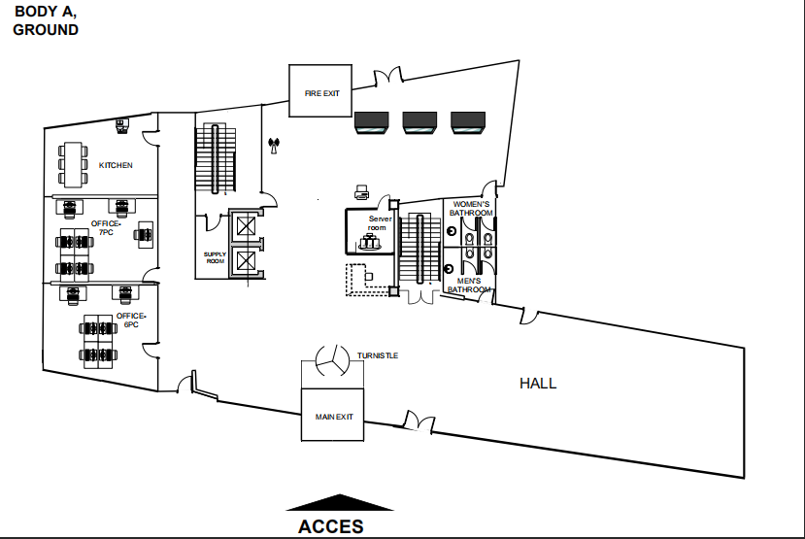

Slide 9
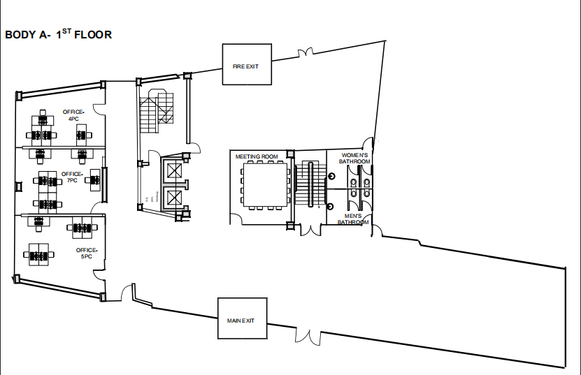

Slide 10
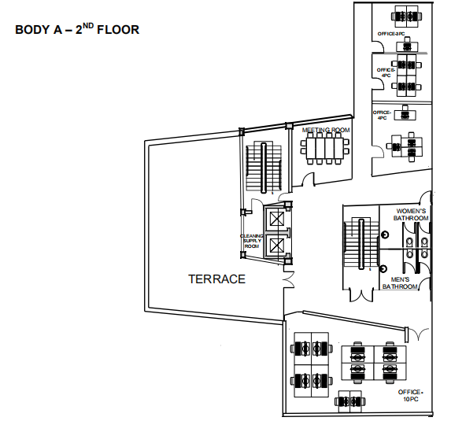
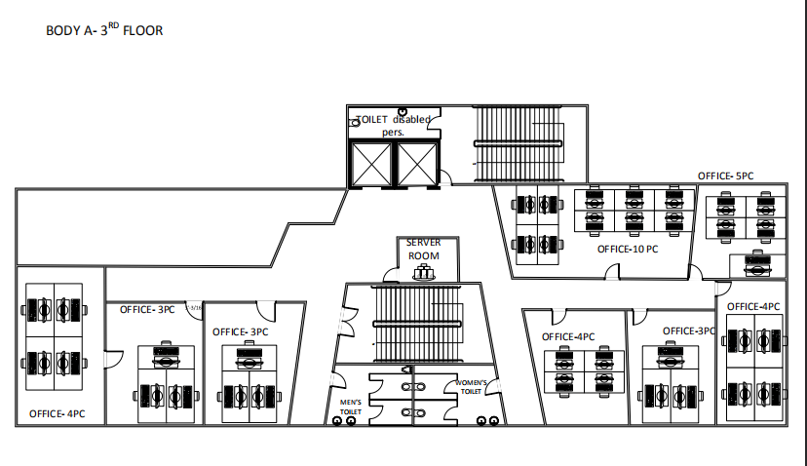


Slide 11
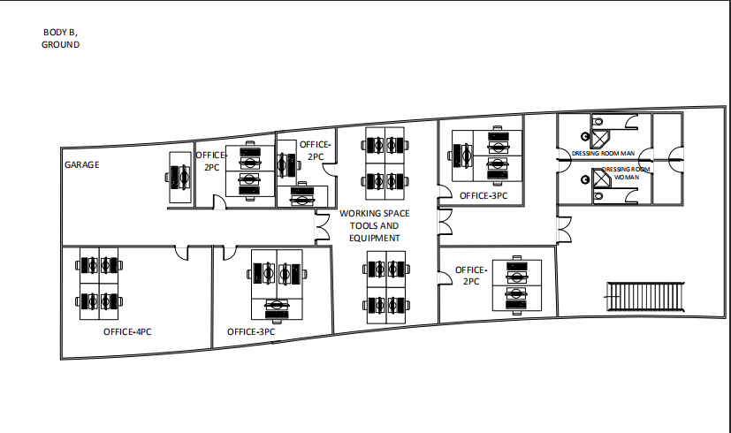
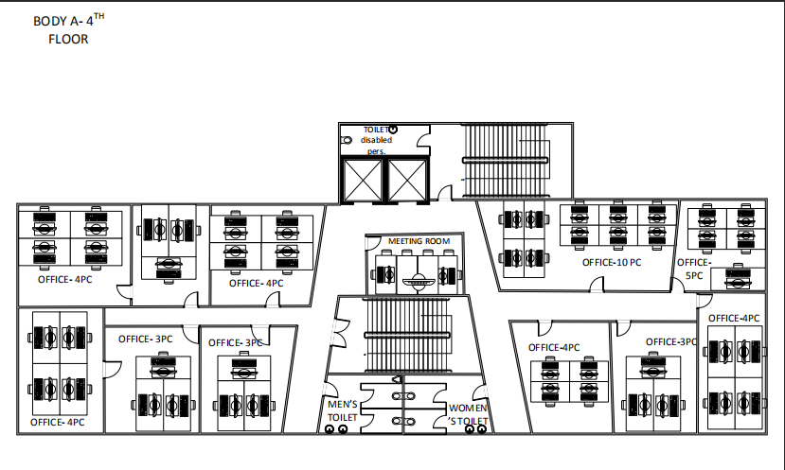

Slide 12
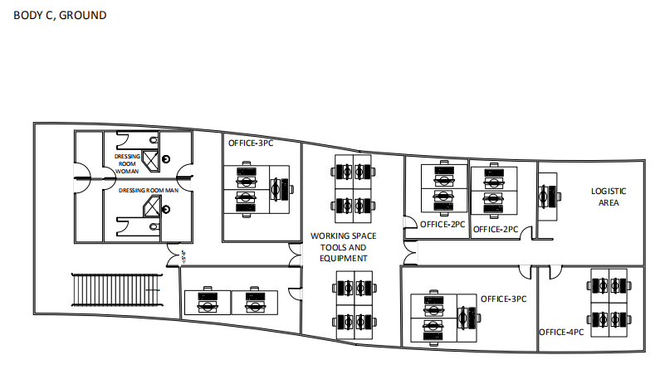
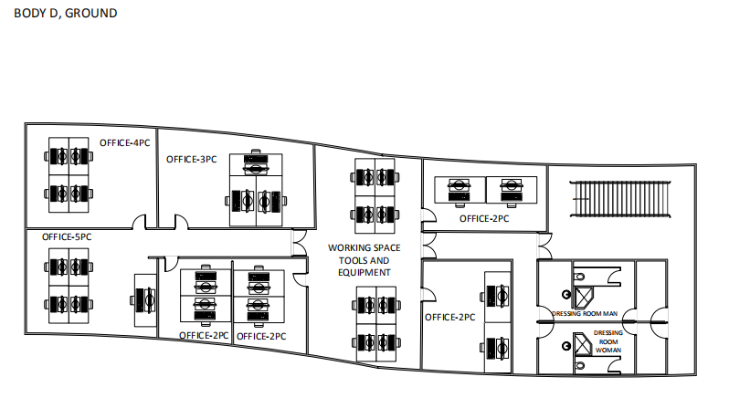
BODY C, GROUND
BODY D, GROUND

Slide 13
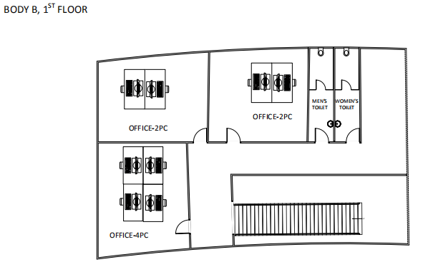
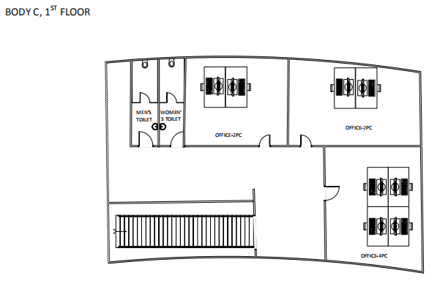
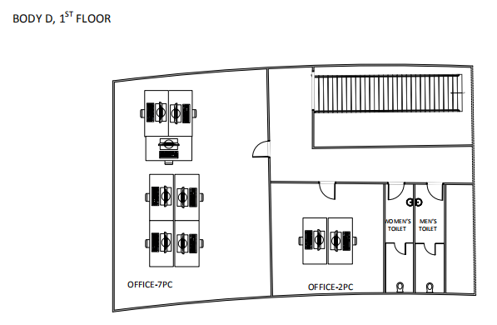


Slide 14
NETWORKING
IP ADDRESS ANALYSIS

Slide 15
IP ADDRESS ANALYSIS
The IP class that will be used is Class C
IP: 192.168.80.0
Subnet mask: 255 .255.255.224
8 Subnet bits: 2^S>= 8 → S=3 (2^3= 8)
5 Host bits: 2^H – 2 >= 25 → H=5 (2^5 – 2 = 30)
In CIDR notation: /27

Slide 16
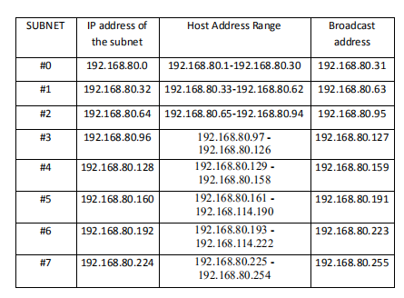

Slide 17
CISCO PACKET TRACER IMPLEMENTATION

Slide 18

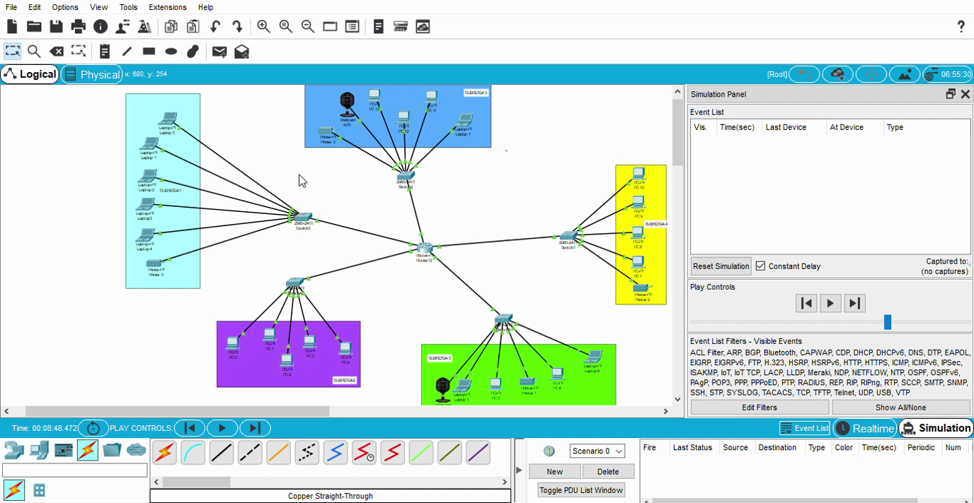

Slide 19
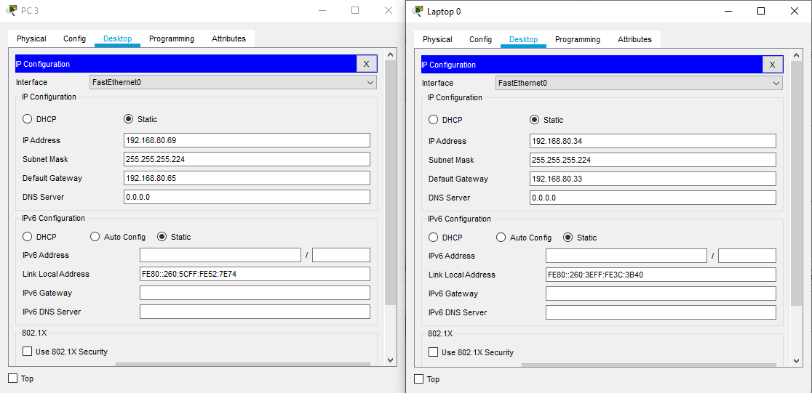
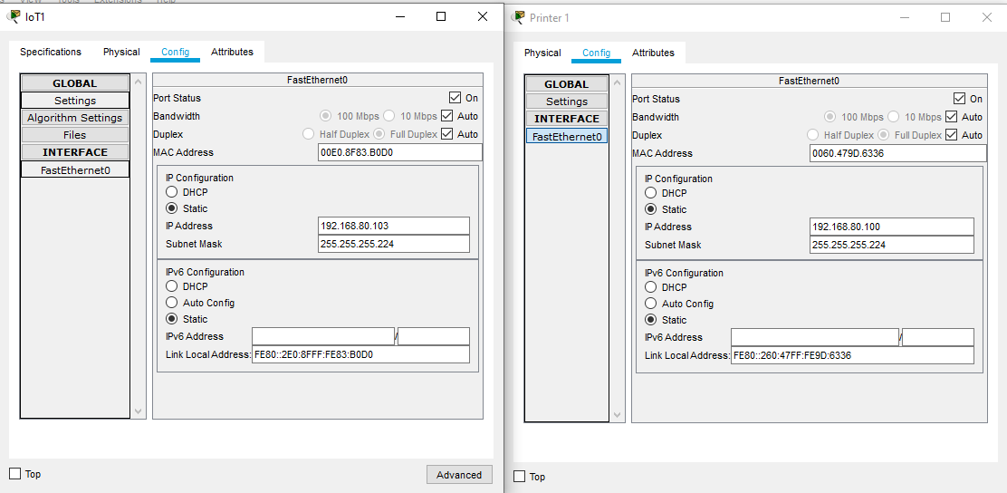
Configuration of devices

Slide 20
ESTIMATED COSTS
MATERIALS COSTS
EQUIPEMNT | PIECES | UNIT PRICE (RON) | TOTAL PRICE (RON)
 | 30 | 109.00 | 3,270
ROUTER ASUS RT-AC68U | 15 | 799.90 | 11,998.5
UTP CABLE CAT5,100 metres | 20 | 113.90 | 2,278
CONNECTORS RJ-45, 10 pcs | 100 | 6.99 | 699
PVC CABLE TRAY, 2 meters | 500 | 4.41 | 2,205
INTERNET OUTLET | 300 | 26.90 | 8,070
SERVER HPE PROLIANT DL380 GEN10 | 1 | 10,997.96 | 10,997.96
FLOOR RACK,12U, 600X1000 mm | 1 | 1,167.34 | 1,167.34
KIT 16 SURVEILLANCE CAMERAS ROVISION | 1 | 2,199 | 2,199
DIGITUS FLOOR RACK COOLER | 1 | 877.56 | 877.56
 | 1 | 545.14 | 545.14
TOTAL (RON) |  |  | 44,307.5
LOGISTIC COSTS
EQUIPEMNT | PIECES | UNIT PRICE (LEI) | TOTAL PRICE (LEI)
DRILL BOSCH (SET) | 2 | 428.99 | 857.98
PLIERS | 5 | 22.62 | 113.1
GLOVES | 4 | 37.50 | 150
LADDER | 3 | 439.11 | 1,317.33
TOOL BOX BOSCH | 4 | 199.99 | 799.96
SET OF SCREWS AND PLUGS | 2 | 41.00 | 82
SET OF CABLE TEST , FIXKIT 12IIN1 | 4 | 297.50 | 1.190
CLIMPING PLIER YATO | 2 | 42.89 | 85.78
LAPTOP ASUS X509FA(Intel® Core™ I5-8265U) | 3 | 2,599 | 7,797
CAR (DACIA DOKKER VAN) | 1 | 20,000 | 20,000
TOTAL (LEI) |  |  | 31,204.34

Slide 21
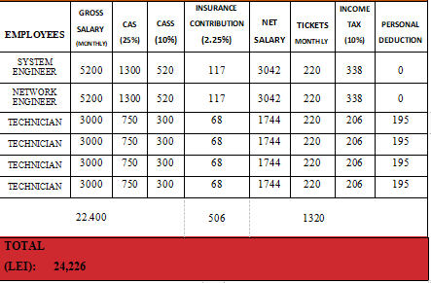
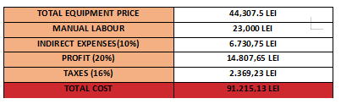
HUMANS RESOURCES
MANUAL LABOUR ESTIMATED TIME: 3 WEEKS EMPLOYEES: 2 ENGINEERS, 4 TECHNICIANS
FOR 3 WEEKS OF WORK, THE COSTS WITH THE SALARY WILL BE: l TECHNICIANS: 10,634 LEI l ENGINEERS: 12,272 LEI TOTAL: 22,906 LEI

